Slide 1

U1/R1 Troubleshooting and image setting
Minimally Invasive Surgery Customer Service Department——Daniel

Slide 2
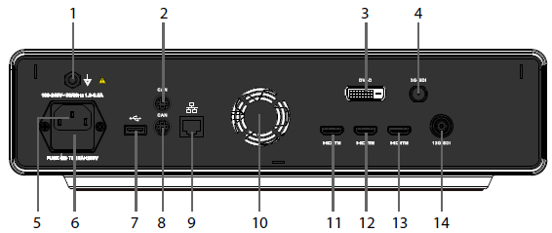
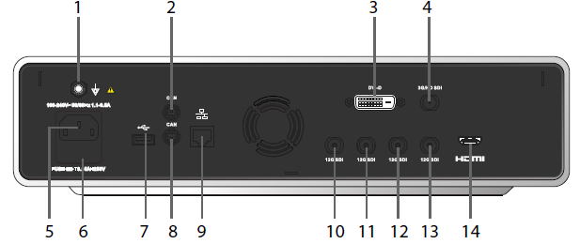
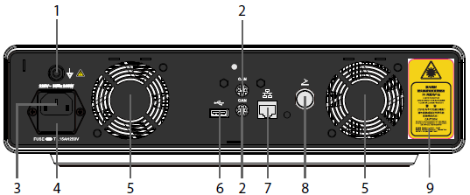
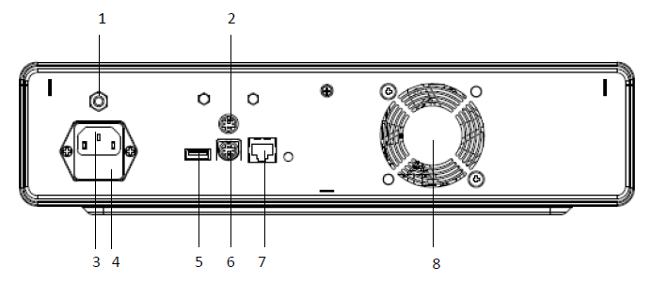
U1/R1 CAN function
R1
U1
HB300R
HB300L
There is CAN connectors on rear panel of U1 and R1 camera system.
We need link the video processor and light source by CAN cable.
Notes:
策略

Slide 3
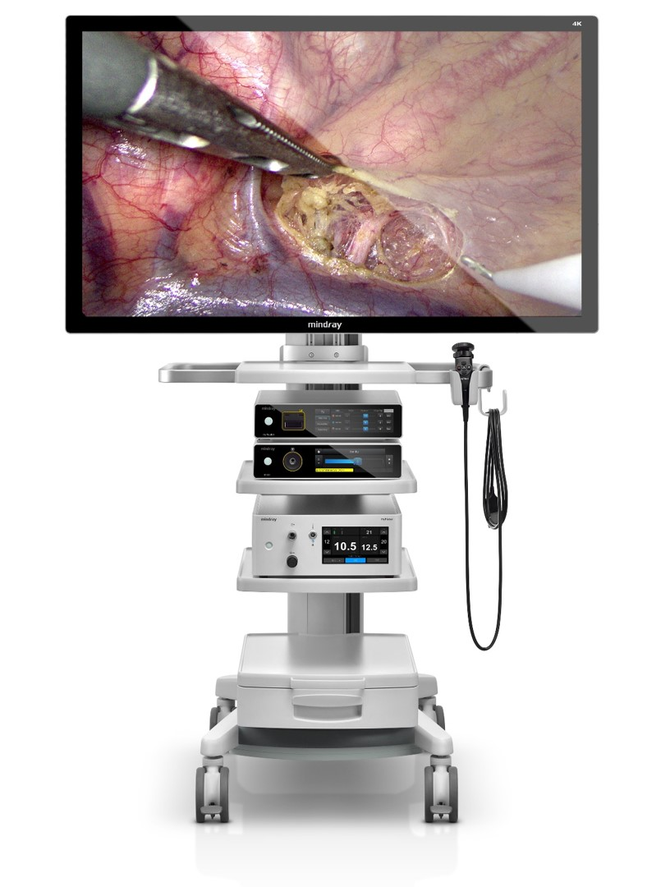
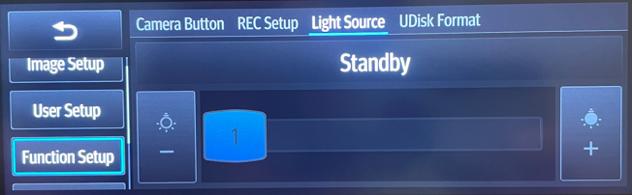
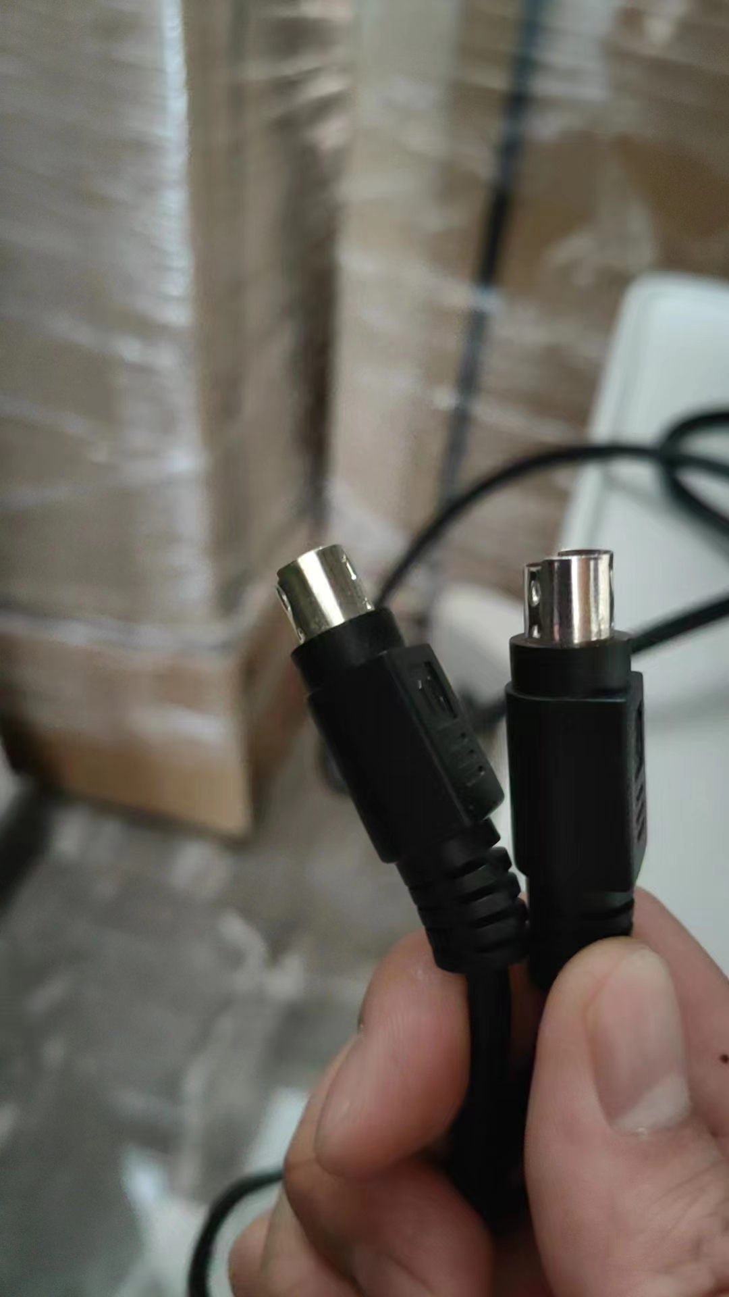
U1/R1 CAN function
With CAN connection, we can realize tow functions on U1.
① Control HB300L by U1.
With CAN cable connection, we can use U1 touch screen to control HB300L and adjust the light source brightness.
Press Menu➡Press Function Setup ➡Select Light source
Then can adjust the light source brightness on U1 touch screen.
All software versions support this function.
② Turn on LED from standby when you conduct white balance.
With CAN cable connection, if the light source (HB300L) is turned on and the LED is standby, when the surgeon conduct white balance, the light source can turn on the LED automatically.
But for this function we need make sure that the software version equal or above 01.13.00.04.
009-009910-00
/Rigid Endoscope/002_U1 System/U1/Software upgrade/Upgrade guide/
/Rigid Endoscope/002_U1 System/U1/Software upgrade/TYJ-22505/
Notes:
策略

Slide 4
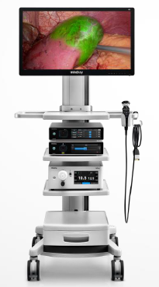
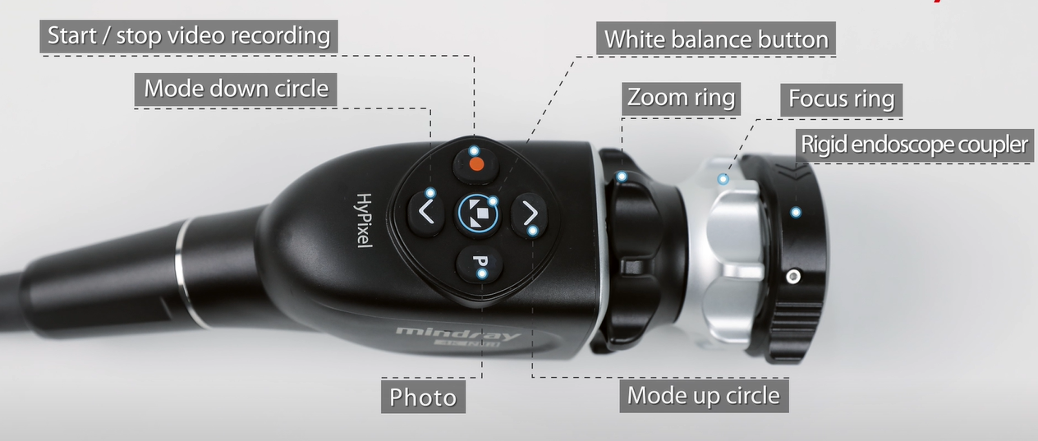
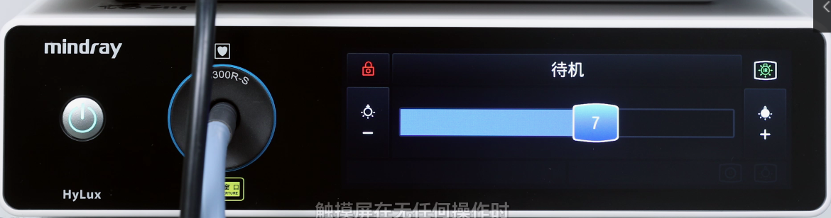
U1/R1 CAN function
With CAN connection, we can realize three functions on R1.
① Shift image mode to fluorescence and turn on fluorescence function. You can shift image mode by press up and down arrow key on camera head. And you can tell that HB300R has turned on infra red laser by observation the mark display on the right top corner of light source touch screen.
Down arrow
Up arrow
② Control HB300R by R1.
An error message will be displayed if you don’t connect the
CAN cable or the CAN cable communication is disconnected.
009-009910-00
③ Turn on LED from standby when you conduct white balance.
But for this function we need make sure that the software version equal or above 01.11.00.04.
/Rigid Endoscope/003_R1 System/R1/Software upgrade/Latest version/
Notes:
策略

Slide 5
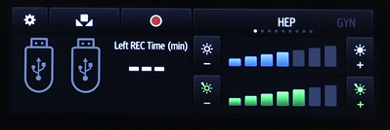
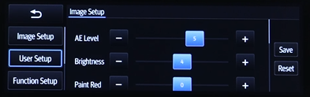
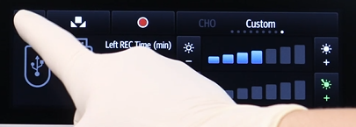
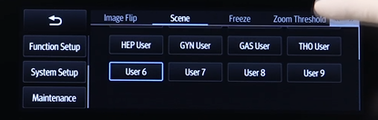
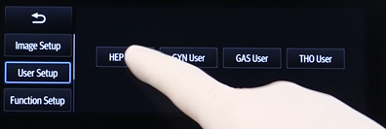
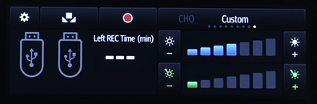
User Setting——R1
HEP User
Notes:
策略

Slide 6
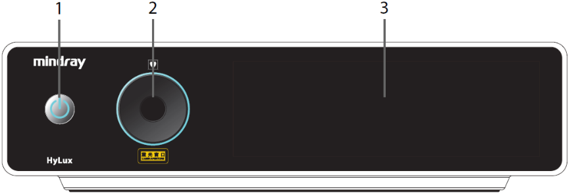
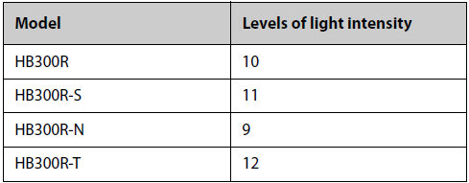
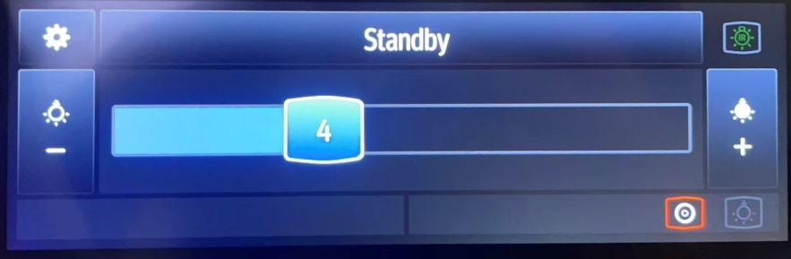
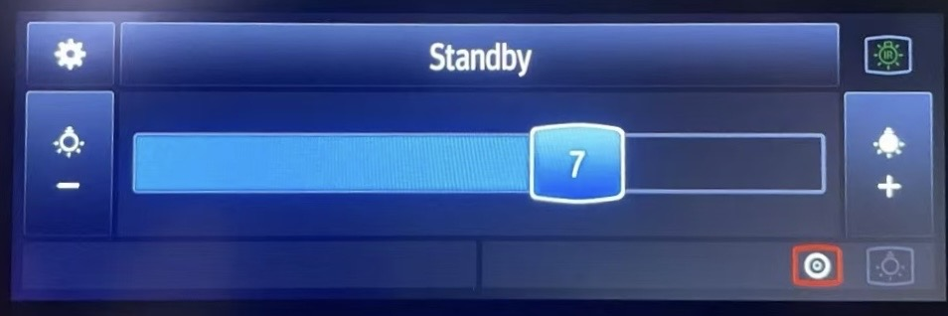
U1/R1 Image setting——Light source adjustment
HB300R has 1 to 10 level for brightness. We recommend to set the brightness from 4-7.
If the telescope with a small diameter, for example, the ENT scope, the urology scope, the hystero scope, We recommend to set 4 or 5. And we recommend to use a 3.5mm light guide.
If the telescope with a big diameter, for example, 5mm laparoscope or 10mm laparoscope. We recommend to set 6 or 7. And we recommend to use a 4.8mm light guide.
Model | LC0005S | LC0003S | LC0005L
Length of light cable | 3000 mm ± 5% | 3000 mm ± 5% | 5000 mm ± 5%
Diameter of exit optical fiber | Φ4.8 mm± 0.1mm | Φ3.5 mm± 0.1mm | Φ4.8 mm± 0.1mm
Minimum bending radius | 50mm | 50mm | 50mm
PN | 115-071632-00 | 115-071631-00 | 115-086094-00
Notes:
策略

Slide 7
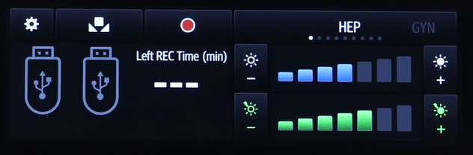
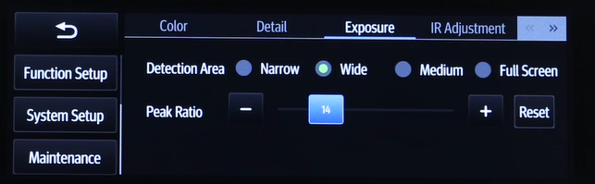
U1/R1 Image setting——Video processor adjustment
During the operation, when the doctor feels that the image is bright, it is not recommended to lower the brightness of the light source, because when the brightness of the light source is low, the image noise will become larger due to the automatic exposure in the camera system. In this case, refer to the white light image adjustment.
AE value
Figure(3) AE Value
Figure(4) Exposure
In R1 camera system, the parameters that control image brightness belong to the category of exposure adjustment. Namely the AE value of the main touch screen, as shown in Figure (3). The detection area and peak ratio in the exposure, as shown in Figure 4.
Notes:
策略

Slide 8
U1/R1 Image setting——Video processor adjustment
AE value
Figure(3) AE Value
Figure(4) Exposure
AE value, detection area belong to the scope of automatic exposure adjustment. The AE value here refers to the average value of image brightness set by the user. The detection area refers to the image area calculated by automatic exposure when calculating the average value of image brightness. When a fixed AE value is specified, automatic exposure will calculate the average brightness of the current image based on the specified detection area.
The "Peak ratio" in the "Exposure Adjustment" means that when the automatic exposure calculates the image average, the Peak Ratio assigns a weight to the overly bright area in the image. Simply put, the larger the "Peak ratio" setting, the darker the image.
Notes:
策略

Slide 9
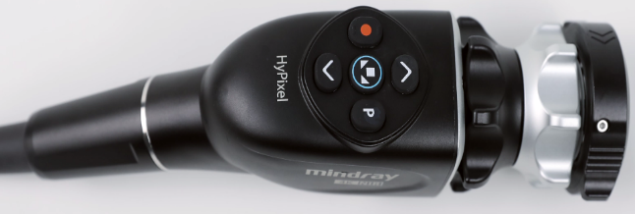
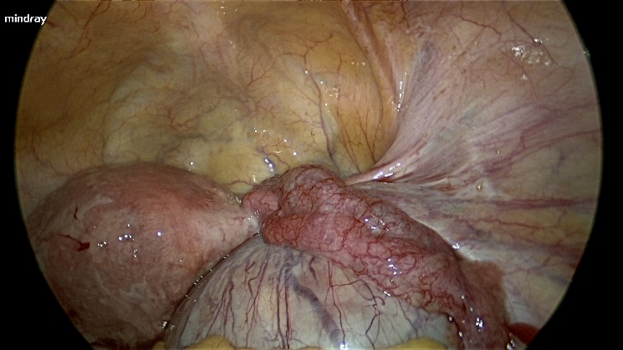
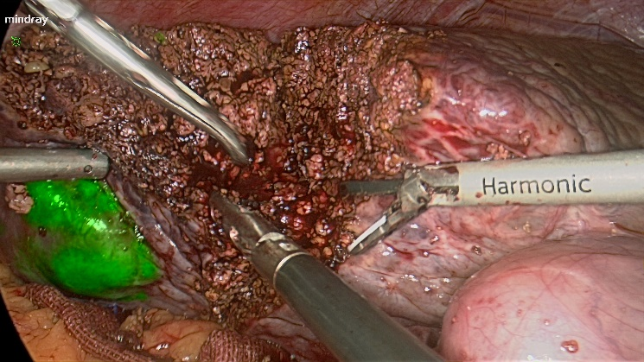
U1/R1 Image setting——Video processor adjustment
Detection area
The setting of the detection area is related to the zoom ring on the camera head(Only R1) which is displayed on the image as the size of the image circle.
After hundreds of surgeries analyses, it is currently recommended to zoom in the image as big as shown in Figure (5). In actual use, if the doctor likes to use full screen, the image difference will not change too much without changing the detection area, as shown in Figure (6).
Figure(5) Recommended image size
Figure(6) Full screen image size
Notes:
策略

Slide 10
U1/R1 Image setting——Video processor adjustment
Adjustment suggestion
If the doctor feels that the image is too dark, he should first increase the AE value shown in Figure (3).
If the doctor feels that the image is too bright, he should first lower the AE value by one level (the default is 4 levels). If he still feels that the image is too bright, he can appropriately increase the “Peak ratio" value in Figure (4).
If the doctor feels that the reflective points in the image are dazzling, he should first increase the "Peak ratio" value in Figure (4).
It is not recommended to adjust the “Detection Area" in Figure (4).
If it is a 5mm laparoscope and you find that the image is dark and the noise is too loud, you can increase the light source by one level, increase the AE value, decrease the "Peak ratio" value, and adjust the combination of the three to improve the image.
AE值
Figure(3) AE Value
Figure(4) Exposure
Notes:
策略

Slide 11
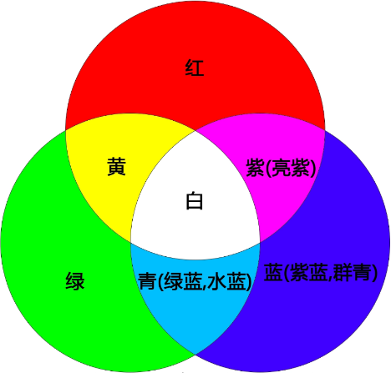
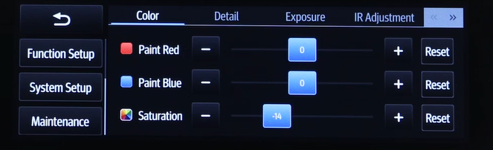
U1/R1 Image setting——Video processor adjustment
Color adjustment
Figure(7) Color setting
Figure(8) RGB
In U1/R1 camera system, there are three parameters for color adjustment, namely red gain(Paint red), blue gain(Paint blue) and saturation, as shown in Figure (7). When adjusting colors, adjust colors according to the principle of three primary colors, as shown in Figure (8). Color adjustment suggestions:
The greater the saturation value, the darker the color of the image and the brighter the visual experience. On the contrary, the lighter the color, the whiter it is.
If the image is purple, first reduce the blue gain and then appropriately reduce the red gain. When you reduce the red gain and find that the image is yellowish, then increase the red gain appropriately.
Notes:
策略

Slide 12
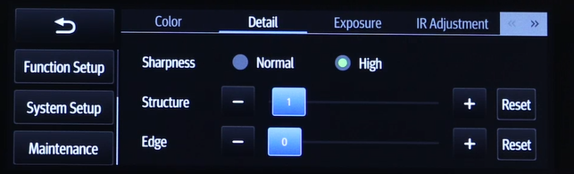
U1/R1 Image setting——Video processor adjustment
Sharpness adjustment
In R1 camera system, there are three parameters for sharpness adjustment, namely sharpness, structure and edge as shown in Figure (9). When "Normal" is selected for sharpness, the image noise is smaller and softer. When "High" is selected, the image noise is larger and sharper. The larger the “structure” value, the noisier and sharper the image. The boundaries in the image (such as blood vessels, liver edges) are enhanced, but too high a value will cause black edges or other unnatural colors to appear on the boundaries. The larger the “edge” value, the image performance is similar to the "structure" parameter. The three parameters here are complementary and interconnected.
Figure(8) Details for sharpness
Adjustment suggestion：
It is generally not recommended to adjust.
"Structure" can be adjusted as a priority when necessary.
Notes:
策略

Slide 13
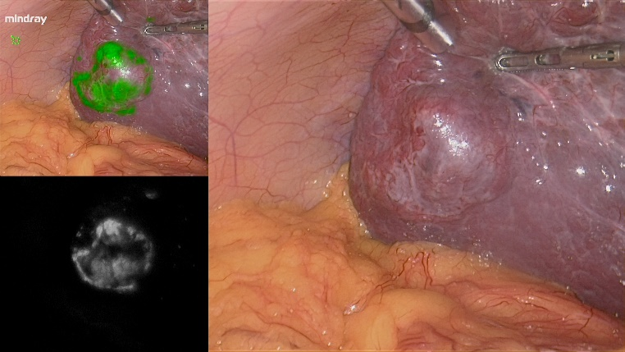
U1/R1 Image setting——Video processor adjustment
Fluorescence adjust——Only available on R1
Fluorescence intensity
Fluorescence area
MIX Green
Figure(10) Fluorescence intensity
IR
Figure(11) Fluorescence area
In R1 camera system, there is only one parameter that provides fluorescence brightness adjustment, as shown in Figure (10). When switching to the three split screen mode, the upper left of the image is MIX Green fluorescence, the lower left is IR(dark) fluorescence, and the right is white light. The fluorescence brightness parameter acts on the green fluorescence in the MIX green fluorescence image, as shown in Figure (11). The larger the value, the brighter the green fluorescence. The fluorescence brightness is related to the distance and angle from the lens to the lesion tissue. The farther the distance, the larger the angle, and the weaker the fluorescence.
Notes:
策略

Slide 14
U1/R1 Image setting——Video processor adjustment
Adjustable range and default value of each parameter
Light source(HB300R)：1~10 level，Recommend 7 for laparoscope.
AE Value：1~7 level，Default 4 in HEP.（Hepatological ）
Detection area：Narrow、Wide、Medium、Full screen，Default wide in HEP.
Peak ratio：0~63，HEP=THO=18(Default). GYN=22(Default).
Paint red、Paint blue：-16~+16，Default=0；
Saturation：-32~+32，Default=-10；
Sharpness：Normal、High，Default=Nornal；
Structure：0~31，Default=19；
Edge：0~7，Default=0；
Fluorescence intensity：1~7 level，HEP=THO=4(Default)，GYN=2(Default).
Notes:
策略

Slide 15
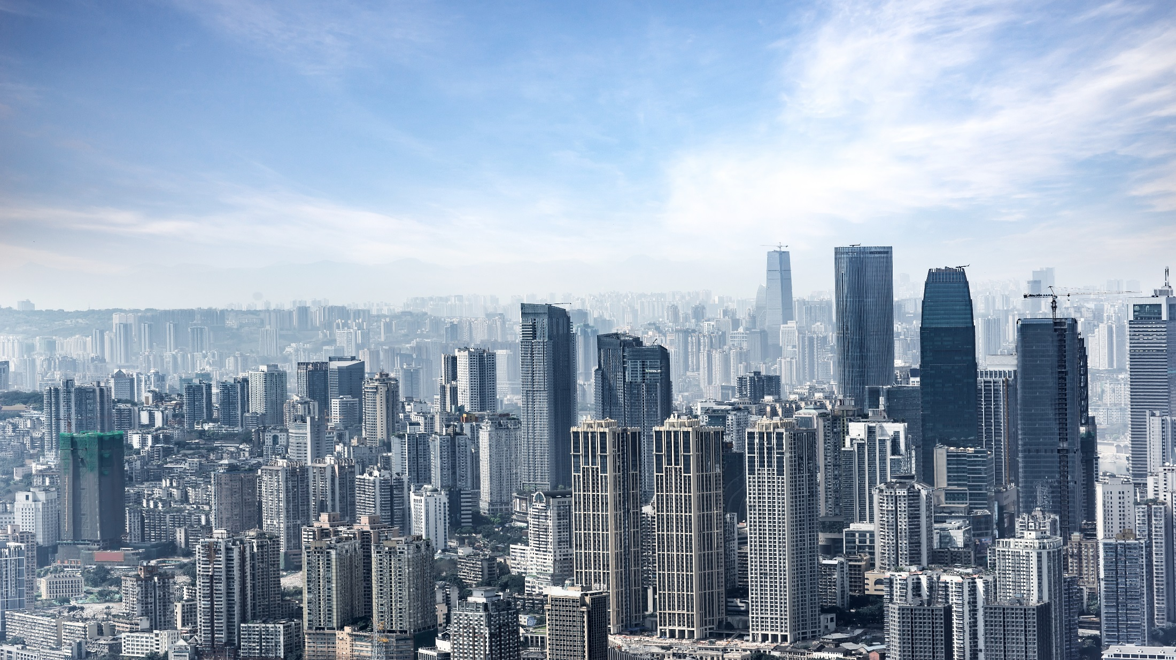
Thank you
Notes:
That’s all.

